Slide 1
Cartography I
LECTURE 1
Notes:
How GISs are applied in our day to day activities is what makes such systems important and what makes the spatial data on which it operates special. The applications to which GISs can be utilised vary from field to field but the supporting principles remain unchanged. This is because of the basic and fundamental way in which we represent geographical objects. It is convenient to represent all geographical objects and phenomenon by points, lines or polygons depending on their characteristics and nature.

Slide 2
Cartography I
History of Cartography
Map Scales and content
Symbolisation
Introduction to map production
Thematic and topographic mapping
Generalisation
Map layout
Relief representation

Slide 3
Cartography I- non-bridge
Map projections- Trig+a little math
Introduction to survey drawings
Basic concepts and types;
Basic drafting- construction of grid lines
Lettering; plotting- Details(offset and polar methods
Longitudinal and cross sections
Contouring; preparation of site(cadastral) plans
Inking. Use of ArcView Software
Practicals- Using ArcView GIS.

Slide 4
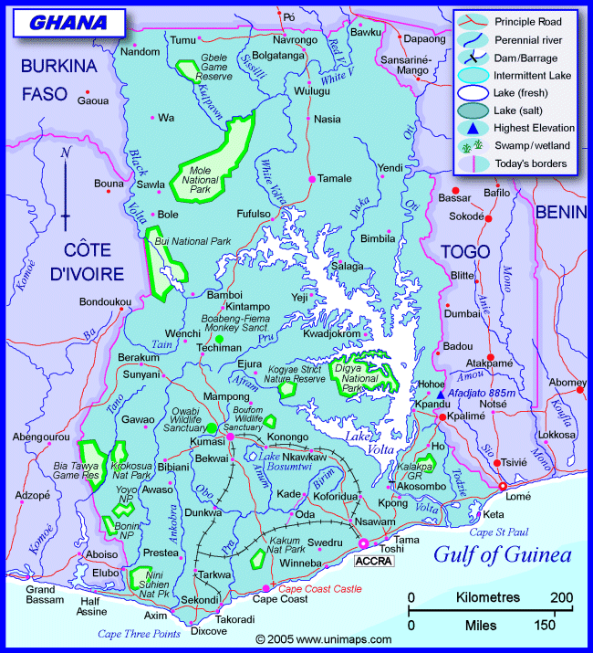
Cartography

Slide 5
Cartography
Cartography means ‘the conveying of spatial information by means of maps’
Not only the manufacturing of maps
With the advent of computers and GIS(Geographical Information Systems) new definition:
‘the information transfer that is centred about a spatial database which can be considered in itself a multifaceted model of geographic reality’

Slide 6
Cartography
Cartography is a branch of graphics
Efficient at handling data 2d/3d
  Manipulation
  Analysis
  Display
With the advent of computers and cutting edge technology
Internet and multi-media- demands
www- 50m maps disseminated through www daily!

Slide 7
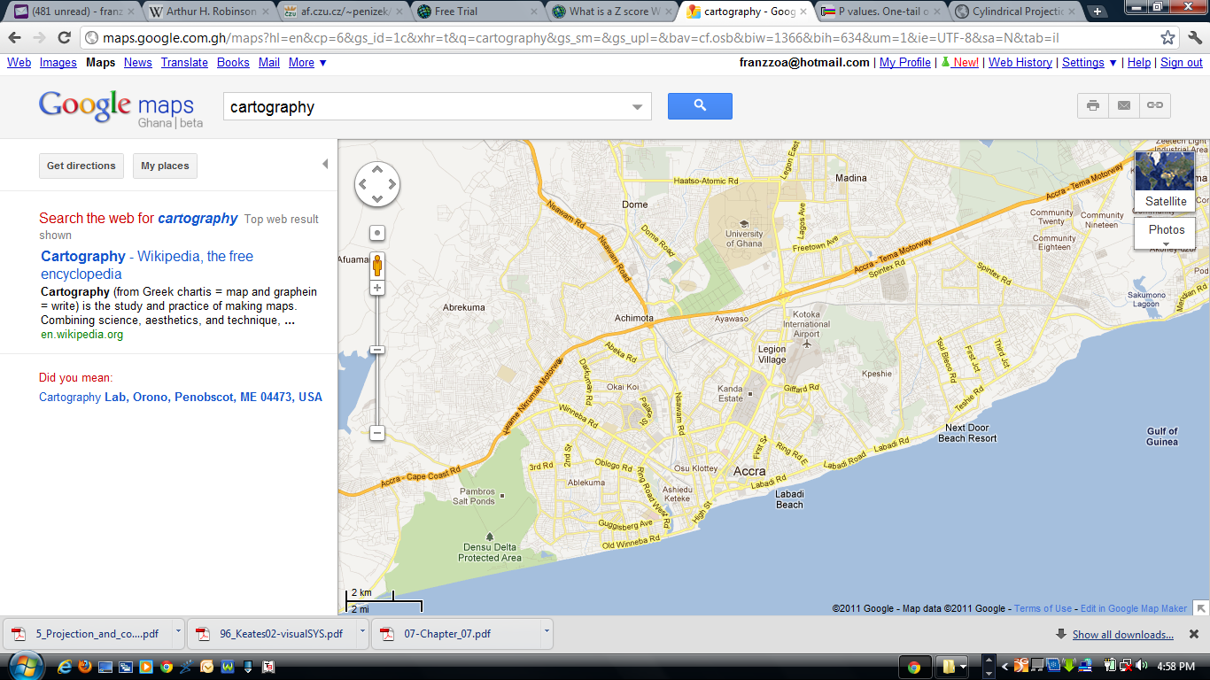
Cartography

Slide 8
Cartography- definition
Cartography is defined as ;
the art, science and technology of making maps.
Cartography is much more than that; it is the study and even the use of maps.

Slide 9
Cartography- definition
Cartography as an art:
Skill
Taste
aesthetics

Slide 10
Cartography- definition
Science=
Accumulation and accepted knowledge that is systematized and formulated wrt general truths and general laws
Technology=
Expertise
Equipments
Tools employed

Slide 11
Cartography
RELATION BETWEEN GIS AND CARTOGRAPHY

Slide 12
Cartography
Today’s cartography
Relationship between
Geographical Information Systems (GIS)
and Cartography

Slide 13

What is GIS
GIS-Is a computer- based system that allows georeferenced data to be input, managed(storage and retreival), manipulated and analysed, and output.
Visualisation- use of a computer to create visual displays, the goal of which is to facilitate thinking and problem solving.

Slide 14
Cartography
Maps existed before GISs
  Could handle input/output
  Transformation and analysis
Maps could be visualisation subset of GIS
Maps are an essential support of handling Geographic Information.
  Maps are direct/

Slide 15
Cartographic GRAMMAR
HOW I SAY WHAT WHOM EFFECTIVE
HOW- METHODS AND TECHNIQUES
I- CARTOGRAPHER
SAY-COMMUNICATING I GRAPHICS THE SEMANTICS OF SPATIAL DATA
WHAT- SPATIAL DATA AND ITS CHARACTERISTICS

Slide 16
Types of Cartography
Types of Cartography
  Exploratory- visualise to stimulate
  Presentation-viz to present to group
  Analytical-Falls between 1 and 2

Slide 17
Types of Cartography
Future of Cartography-prepare
  Maps users need adaptation
  Map anything –sea bottom, other planets
  Keep up with technology
Who needs cartography?
  Where ‘here’ is from ‘there’
  How to get ‘there’ from ‘here’
  How ‘here and there’ look like.

Slide 18
Current trends of Cartography
  Not much- User has to accept the map as created by Cartographer
  Yet, Cartography is more than just making maps today
  Digital world transformed not just Carto. But Geomatics (geospatial techniques)

Slide 19
Advantages of computers in cartography
  Integration of mapping Sciences- Remote Sensing, Photogrammetry, Surveying
  Reduction of tedium of Production
  Computer Networks
  Flexibility in design- experimental maps
  Updates/Easier revision (minor)
  Popularity of computer graphics- vizn
  Less training required to make maps

Slide 20


Carto in the hands of ‘Tom/Dick + Harry =’
Errors
Errors
^*&%!
C a r t o g r a p h I c d I s a s t e r
^*&%!
Errors
Errors

Slide 21
DisAdvantages of computers in cartography
  Those not trained in Cartography making maps!
  Cost of digital data
  Decline of trad. Carto
  Because data is digital- dubious data unchallenged
  Need for higher training- databases, OS and programming

Slide 22
What is a map?

Slide 23
QUESTIONS:
?

